Slide 1
Deleter and Reload Data in InfoCube
Milind Parab

Slide 2
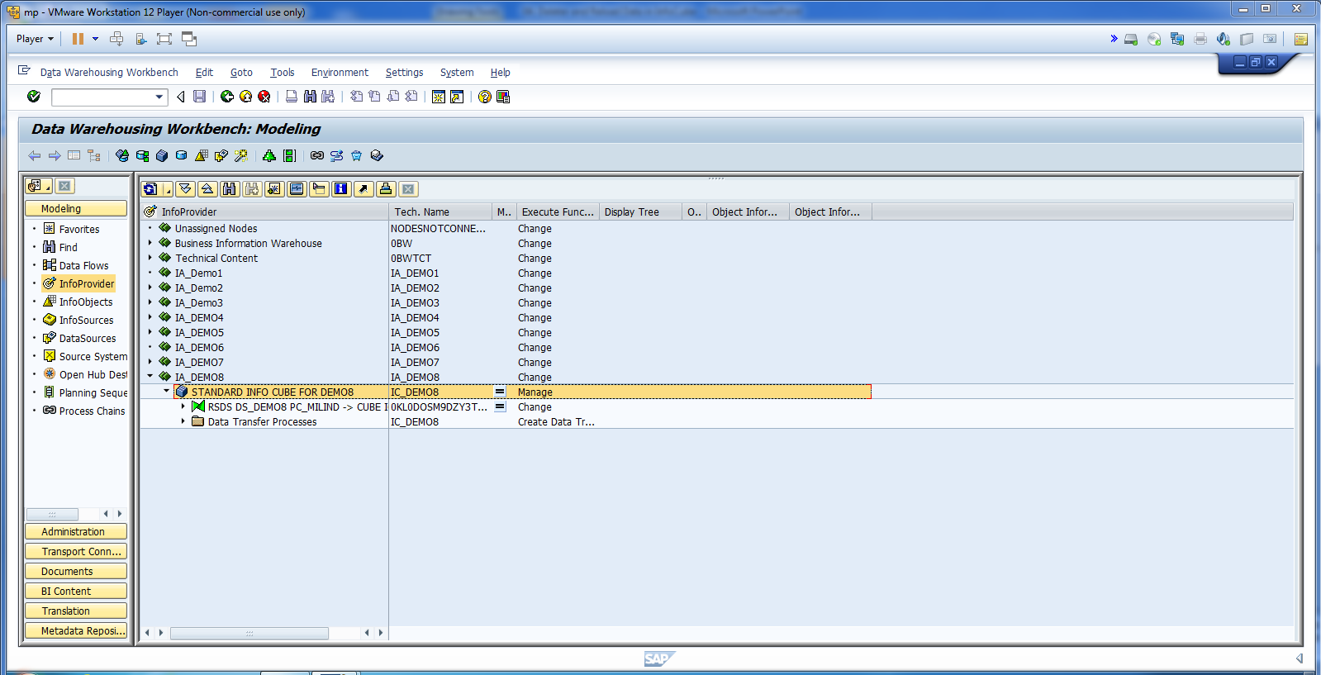
Go to the Info Provide.

Slide 3
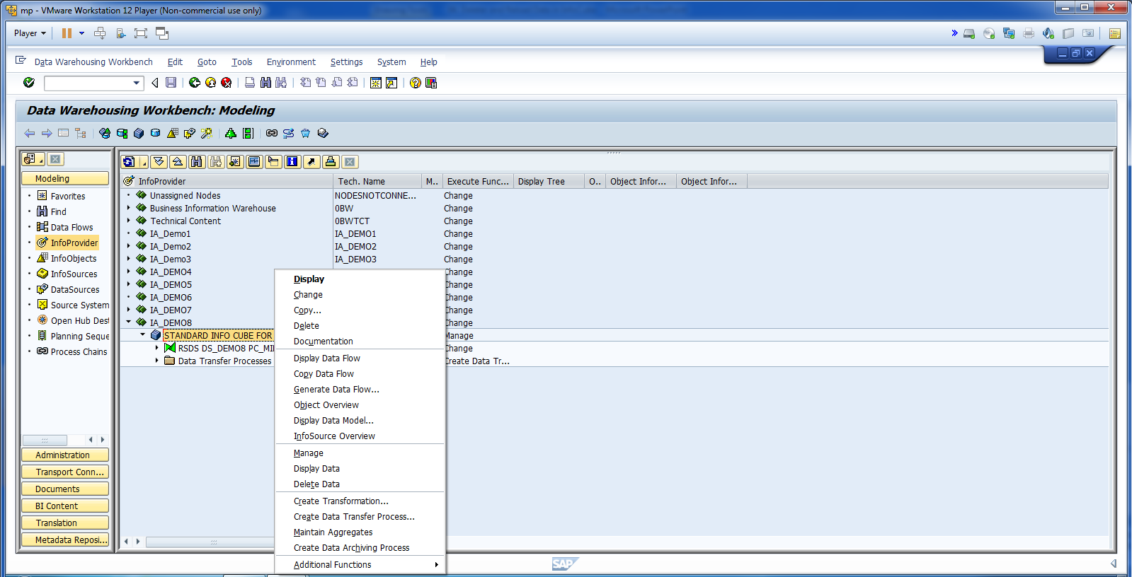
Check if data loaded in InfoCube.

Slide 4
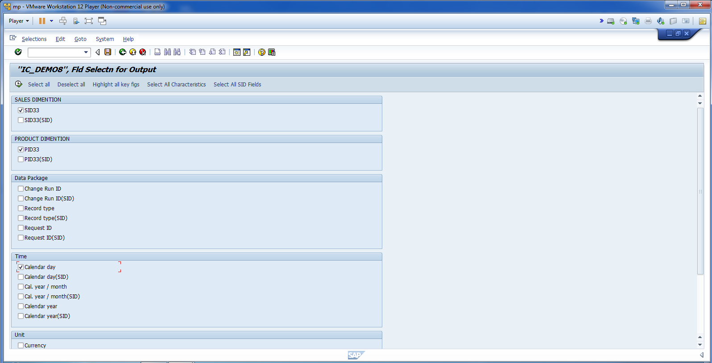
Select Required Fields and Execute.

Slide 5
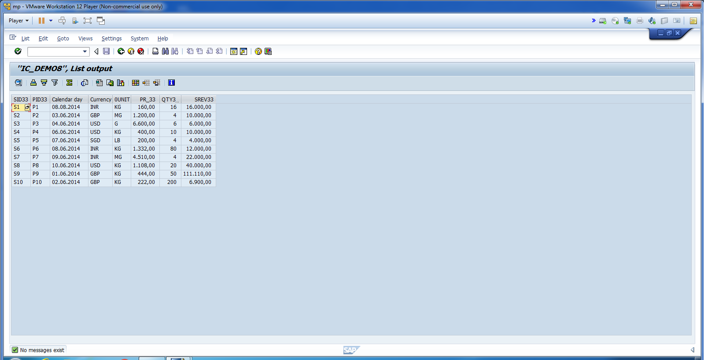
Data Loaded in InfoCube.

Slide 6
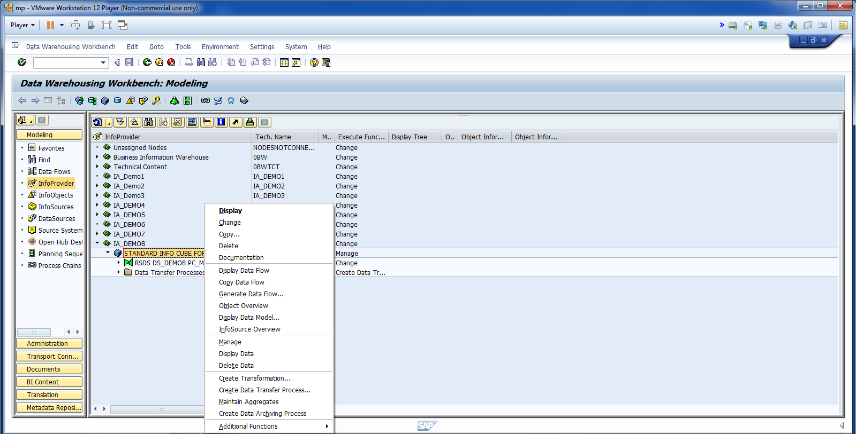
Right Click on InfoCube and Delete Data.

Slide 7
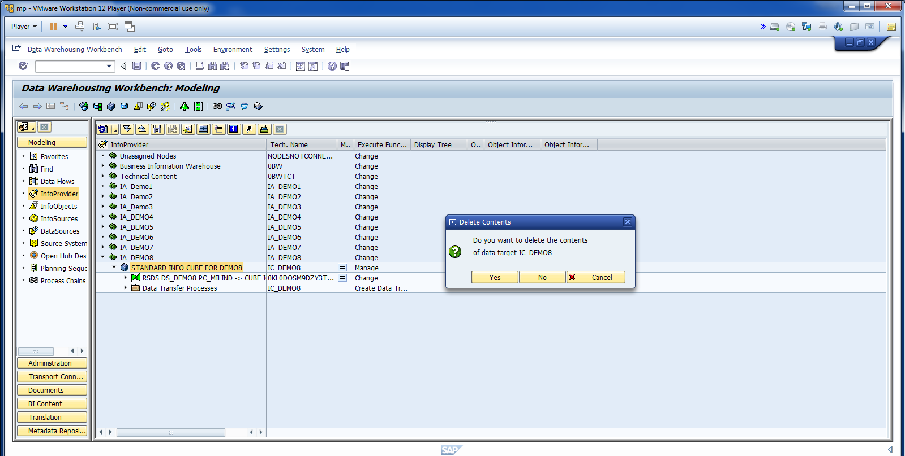
Say Yes.

Slide 8
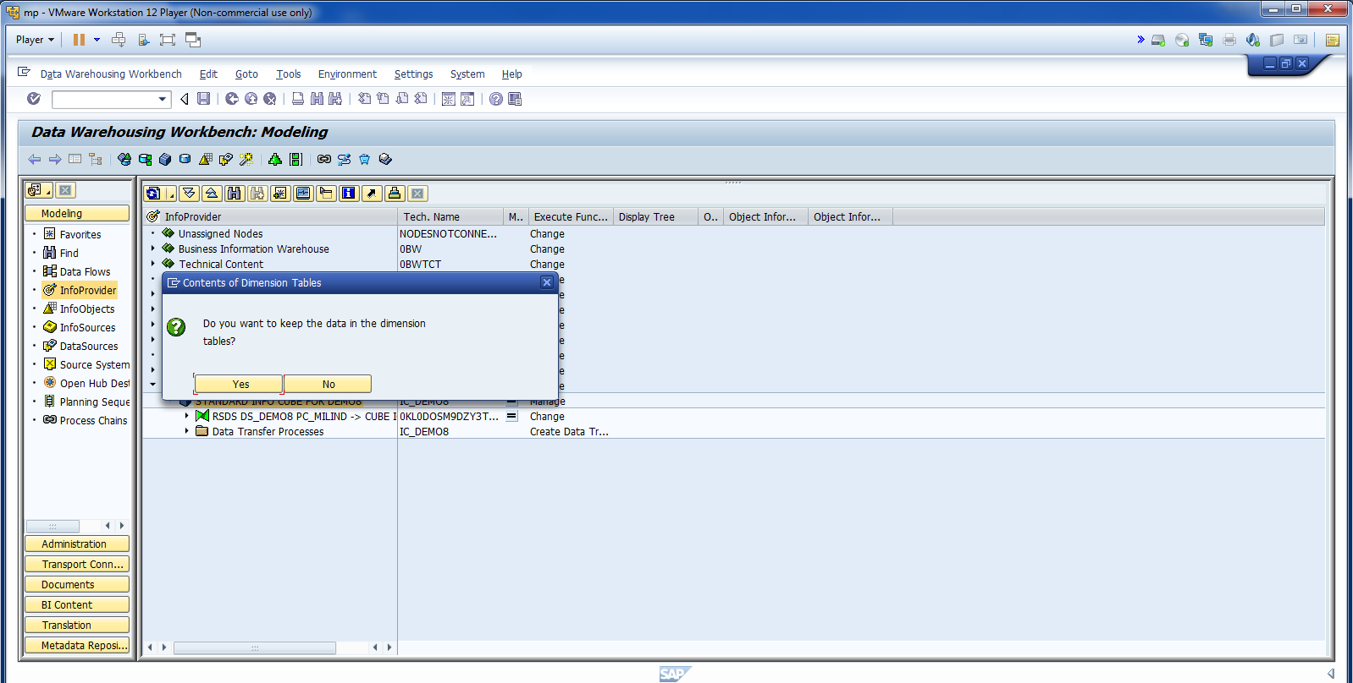
Say No.

Slide 9
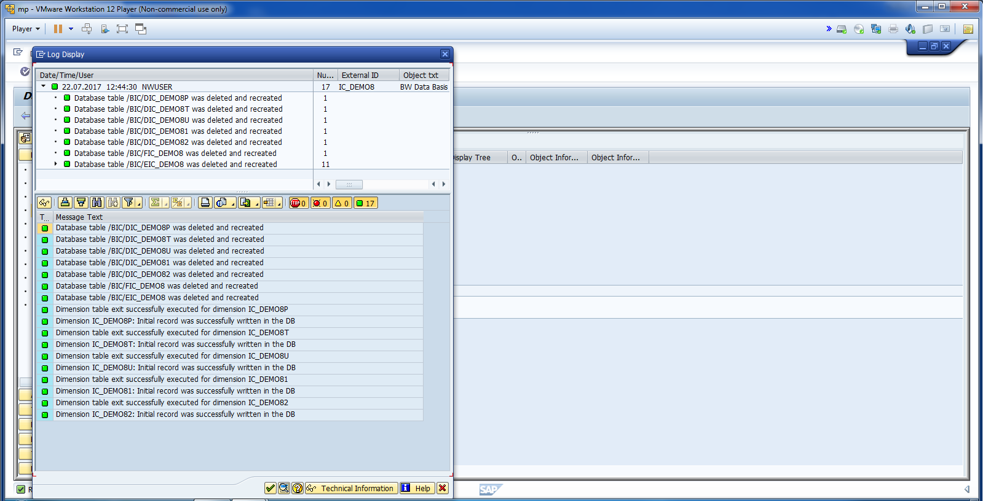
Cont.

Slide 10
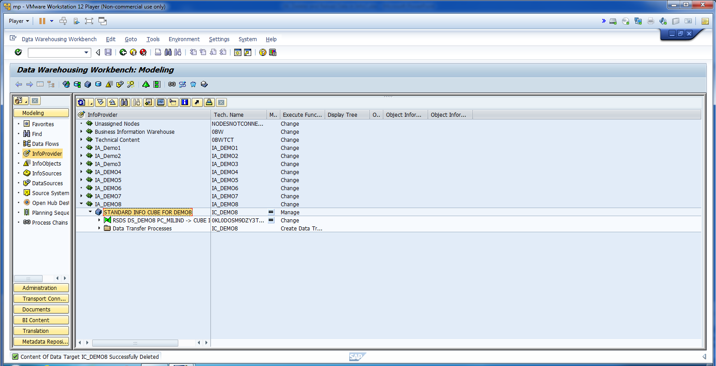
Cont.

Slide 11
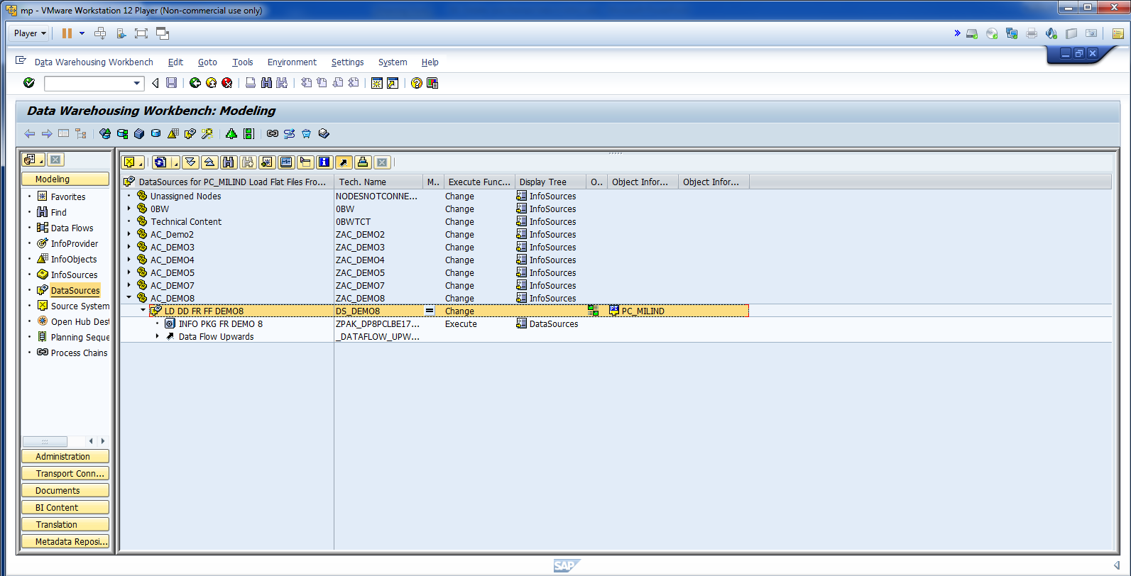
Now, go let’s delete the data from PSA.

Slide 12
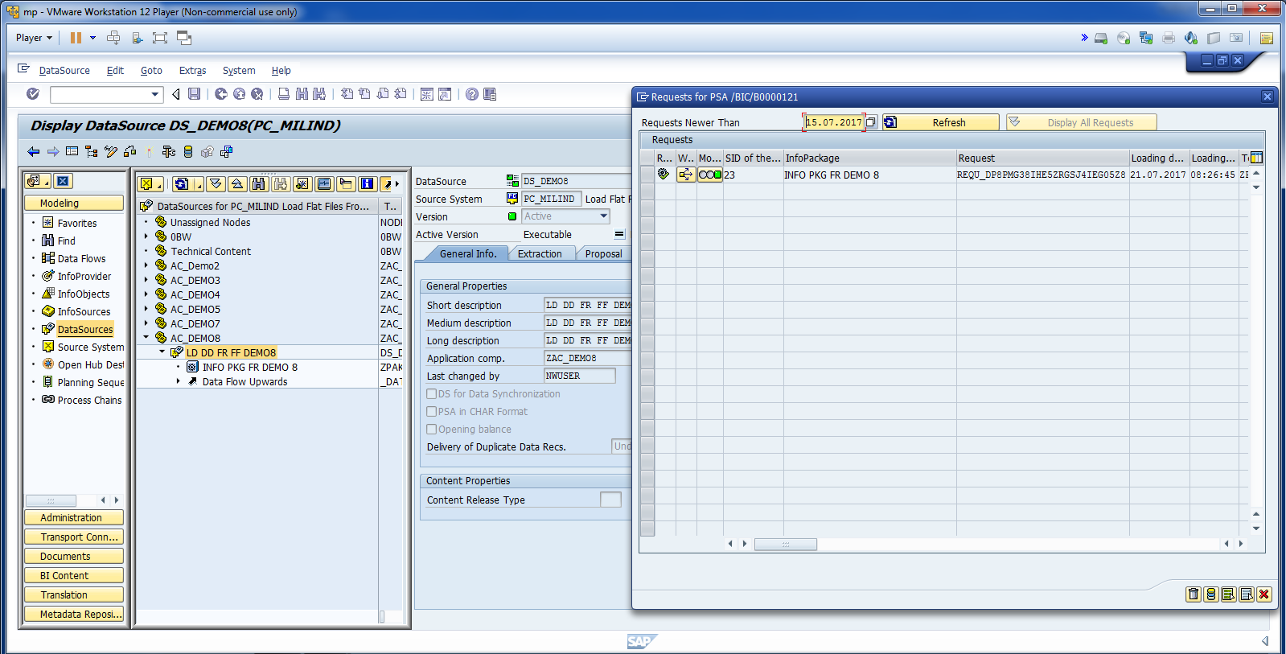
Click on Data Source, and Click on Manage PSA Icon.

Slide 13
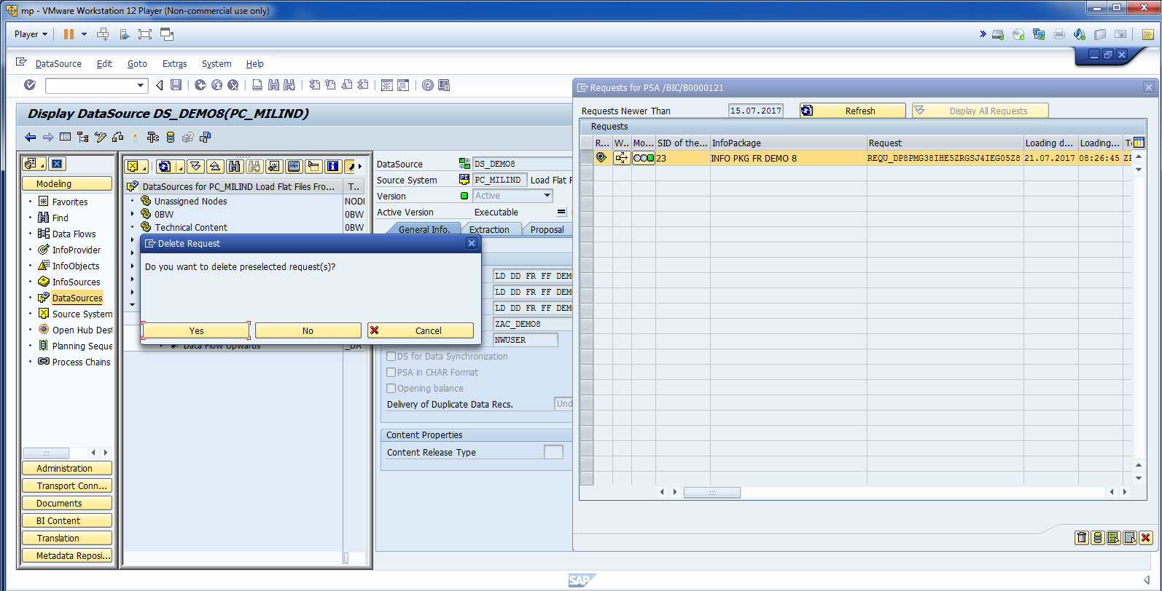
Delete Data.

Slide 14
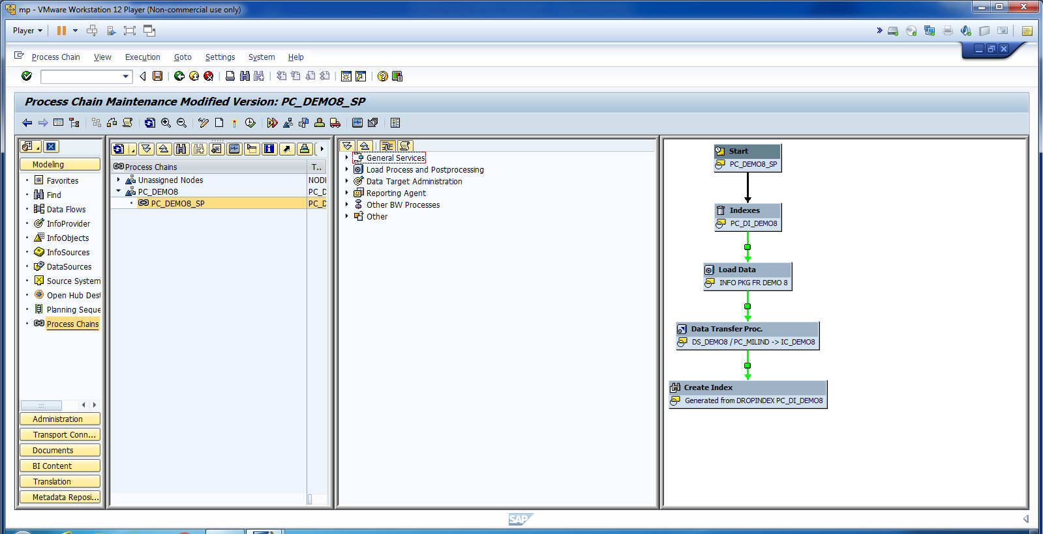
Click on Schedule.

Slide 15
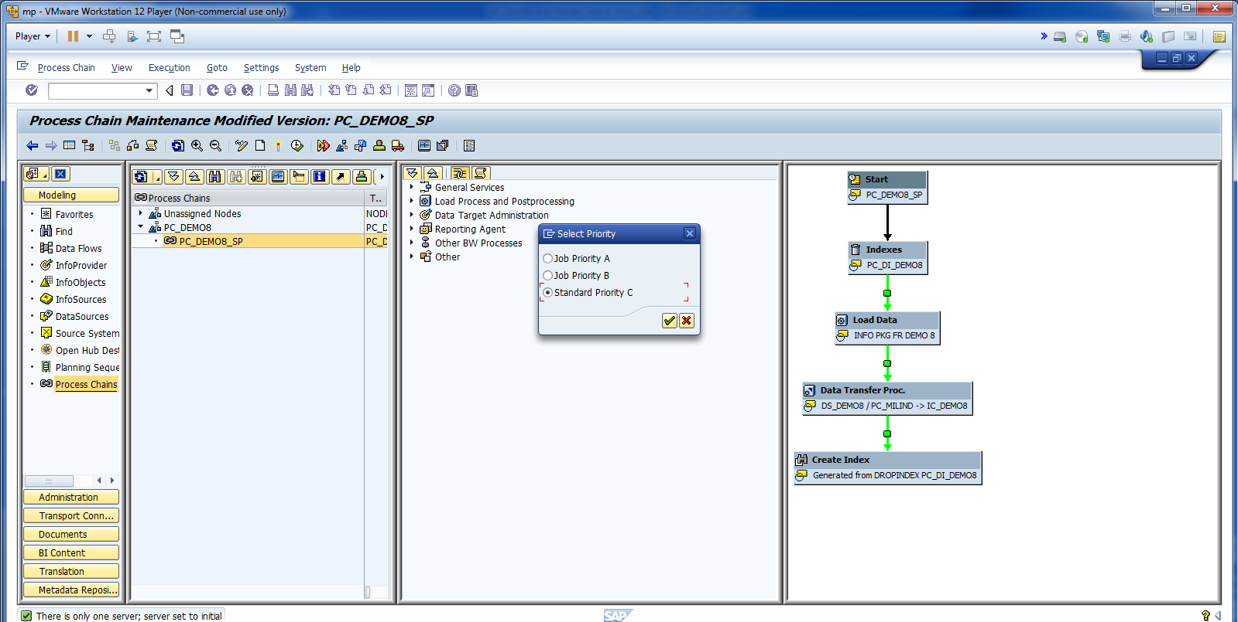
Cont.

Slide 16
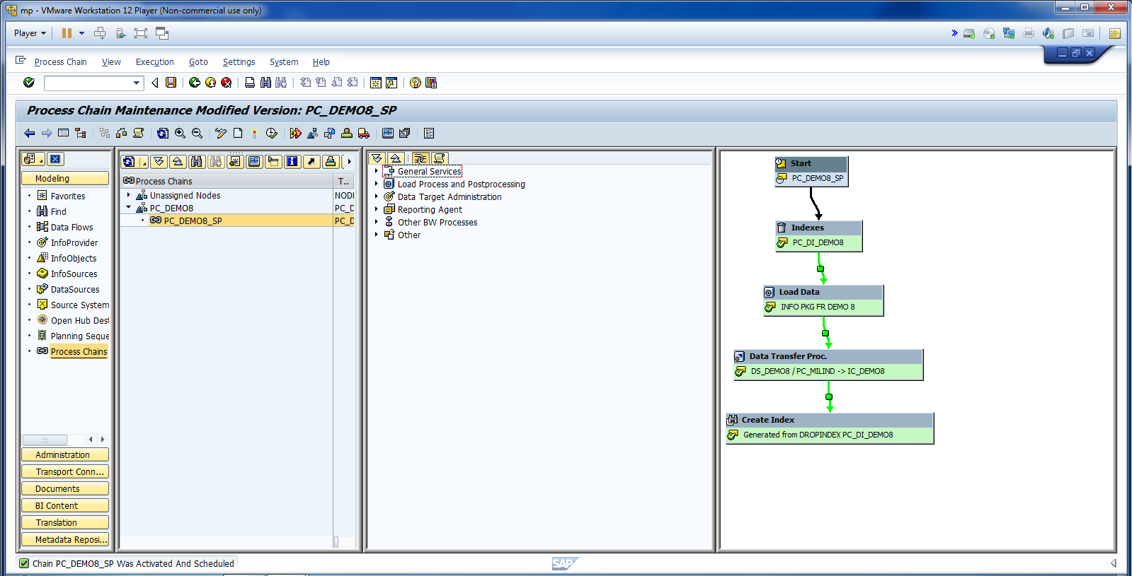
Cont.

Slide 17
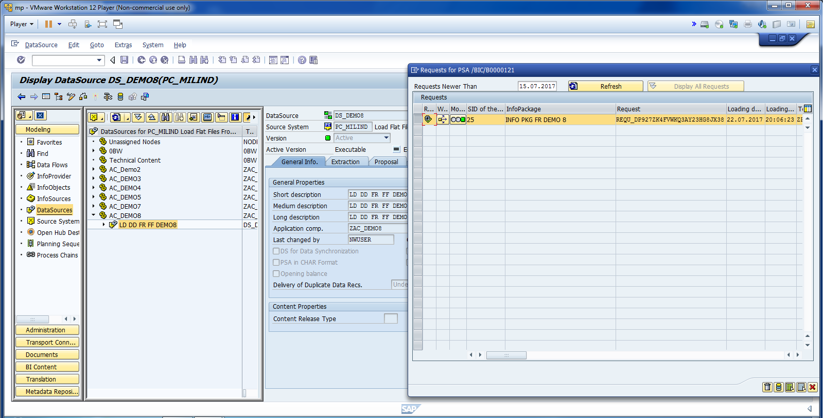
Data has been loaded to PSA.

Slide 18
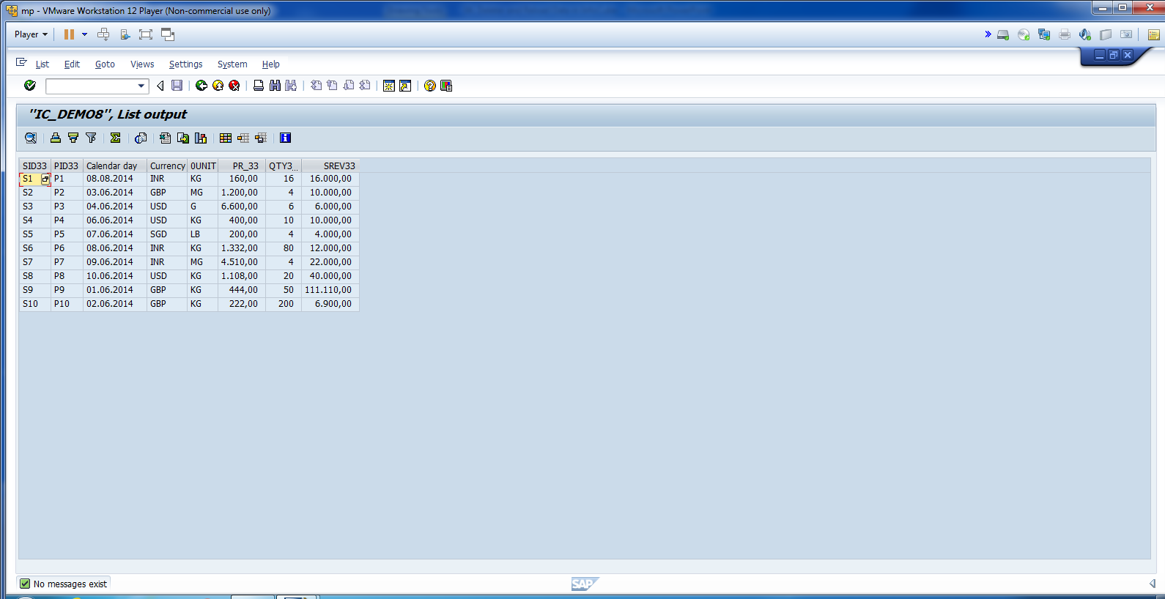
Now, check the data in InfoCube.

Slide 19
Data Loaded in InfoCube successfully.

